Slide 1
2016– 2017
Student of the Month
Pre-Kindergarten
Kendell Cato
Principal
Teacher

Slide 2
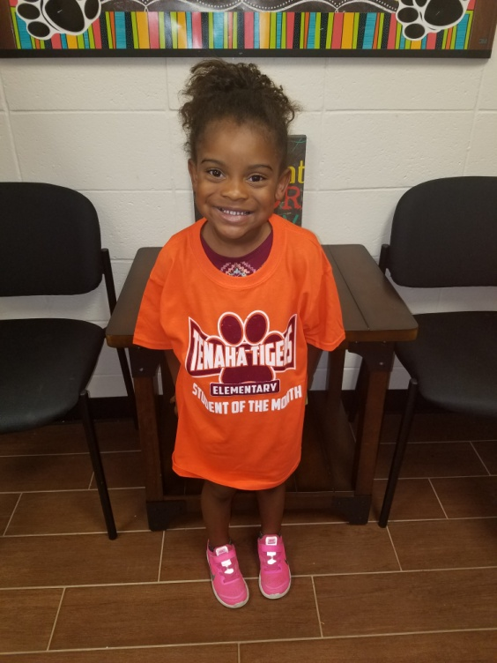
2016– 2017
Student of the Month
Pre-Kindergarten
Kendell Cato

Slide 3
2016– 2017
Student of the Month
Kindergarten
Bryan Solozano
Principal
Teacher

Slide 4
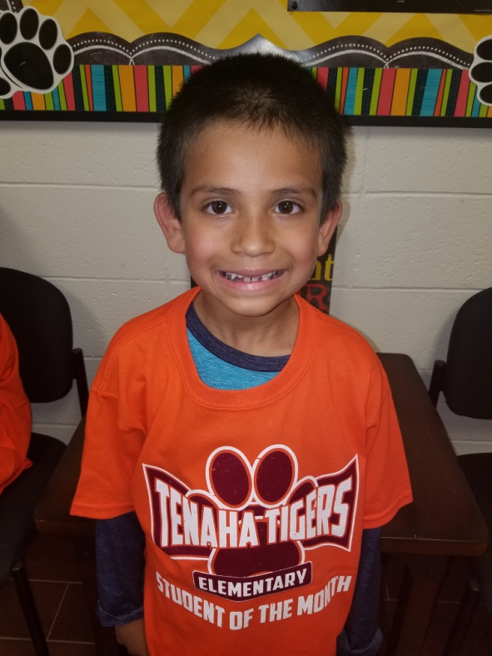
2016– 2017
Student of the Month
Kindergarten
Bryan Solozano

Slide 5
2016– 2017
Student of the Month
1st Grade
Miriam Flores
Principal
Teacher

Slide 6
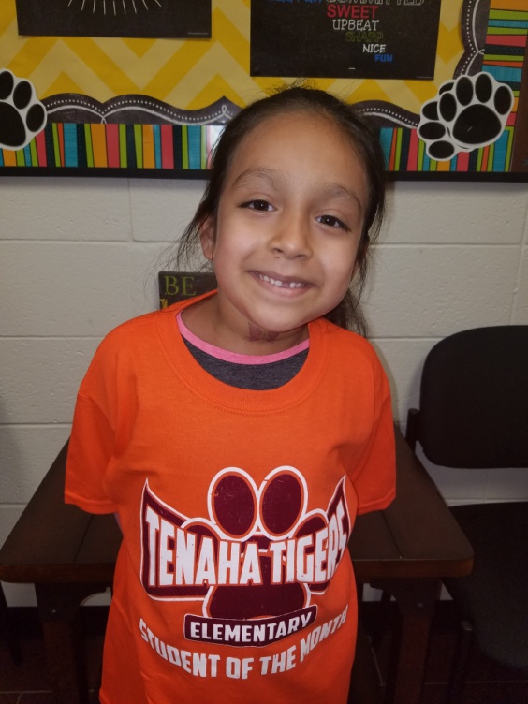
2016– 2017
Student of the Month
1st Grade
Miriam Flores

Slide 7
2016– 2017
Student of the Month
2nd Grade
Elsa Flores
Principal
Teacher

Slide 8
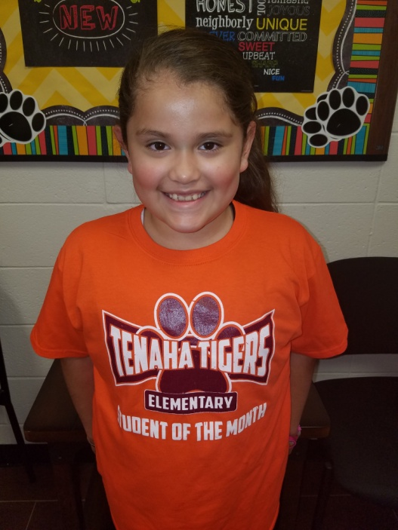
2016– 2017
Student of the Month
2nd Grade
Elsa Flores

Slide 9
2016– 2017
Student of the Month
3rd Grade
Adrian Ramirez
Principal
Teacher

Slide 10
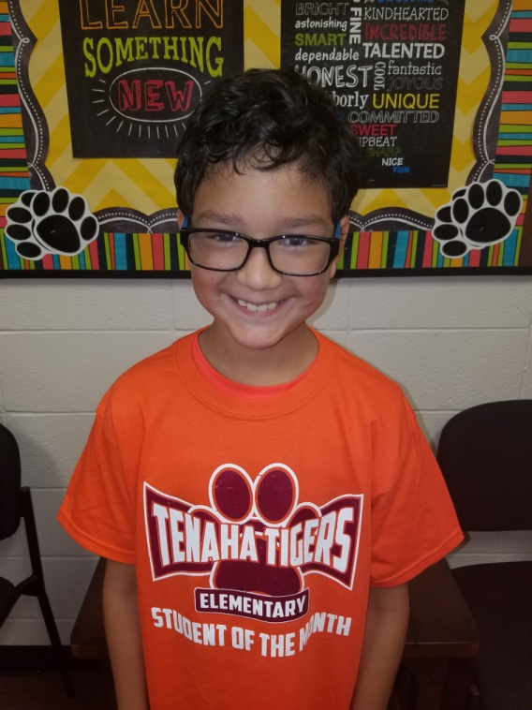
2016– 2017
Student of the Month
3rd Grade
Adrian Ramirez

Slide 11
2016– 2017
Student of the Month
4th Grade
Deara Mayer
Principal
Teacher

Slide 12
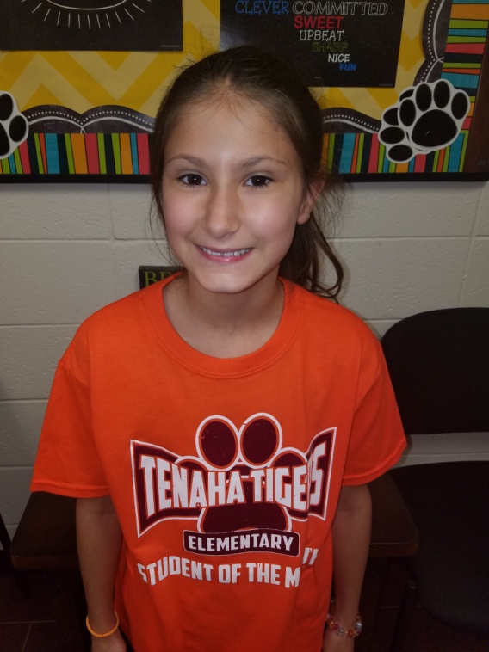
2016– 2017
Student of the Month
4th Grade
Deara Mayer

Slide 13
2016– 2017
Student of the Month
5th Grade
Leonardo Martinez
Principal
Teacher

Slide 14
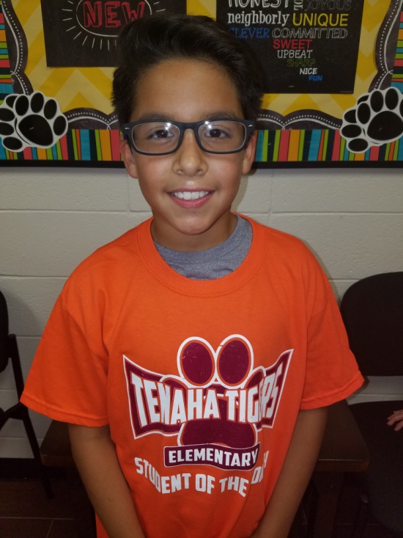
2016– 2017
Student of the Month
5th Grade
Leonardo Martinez

Slide 15
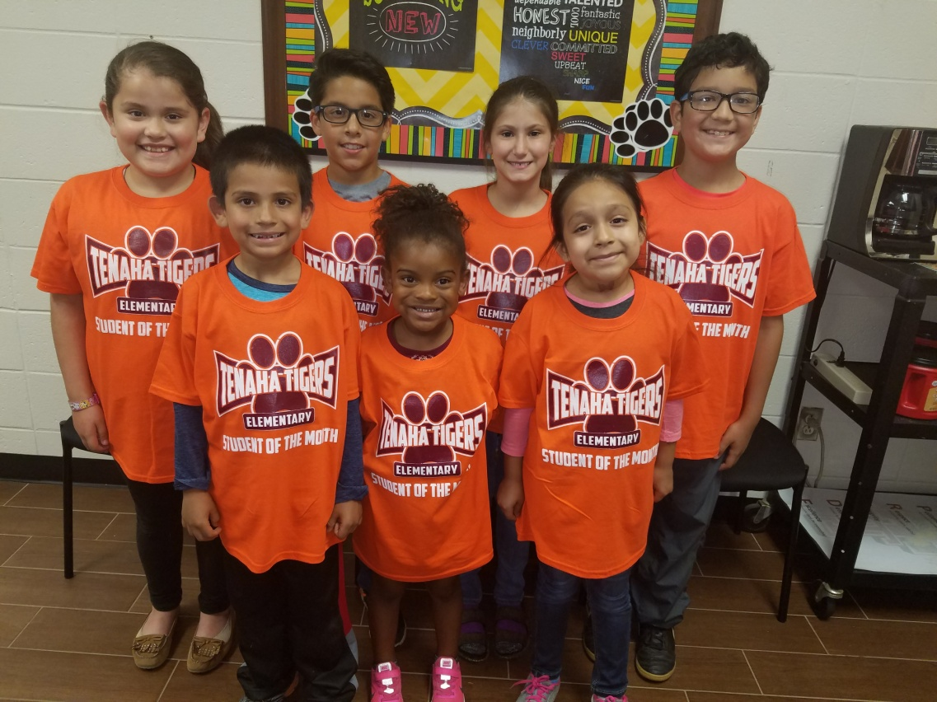
2016– 2017
Elementary Students of the Month
Elsa Flores, Leonardo Martinez, Deara Mayer, Adrian Ramirez,
Bryan Solorzano, Kendyll Cato, Miriam Flores
May

